Slide 1
Dimensional Reduction
Session 21-22

Slide 2
Learning Outcome
LO 1: Explain the fundamental of machine learning concept
LO 2: Interpret the distribution of dataset using regression method
LO 3: Experiment classification and clustering algorithm from given dataset

Slide 3
Outline
Curse of Dimension
Principal Component Analysis
Linear Discriminant Analysis
t-distributed stochastic neighbor embedding

Slide 4
Curse of Dimensionality

Slide 5
Curse of Dimensionality
High dimensional data refers to data with a large number of features, variables or dimensions often represented by the columns in a dataset, where each row is an instance or observation.
The term ‘curse of dimensionality’ coined by Richard Bellman refers to the difficulty of dynamic optimization with many variables.
the following issues are faced when working with high dimensional data:
Working with large dimensional data is computational challenging. Processing, Storing, Communication of high dimensional data require substantially more computational resources
Large dimensional data is very hard to visualize and interpret
generally as number of features increases redundancy also increases – more noise is added to data than signal. This result in degradation of performance of all analytic methods.

Slide 6
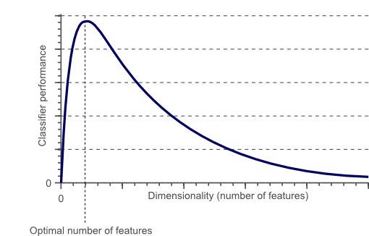
Clustering Analysis
As the dimensionality increases, the classifier’s performance increases until the optimal number of features is reached. Further increasing the dimensionality without increasing the number of training samples results in a decrease in classifier performance.

Slide 7
Curse of Dimensionality
Why do we have a huge number of dimensions in our data?
in the data gathering or extraction phase, we collect data from a lot of all possible places and combine it, which results in a huge no. of features in our dataset. So, to solve real-world business problems we generally require a lot of informations and hence more features are present in the data.
We usually have categorical features in our dataset as well, but a lot of Machine Learning models don’t work well with categorical data. So, what we do is use feature encoding technique(conversion of a categorical variable to numerical features) such as one-hot encoding, which creates a lot of dummy variables for each category, i.e it increases the number of dimensions.
How to solve curse of dimensionality?
Dimensionality Reduction

Slide 8
Curse of Dimensionality
Dimensionality Reduction
Dimensionality reduction is the transformation of data from a high-dimensional space into a low-dimensional space so that the low-dimensional representation retains some meaningful properties of the original data.
Advantages of Dimensionality Reduction:
It reduces the dimensions of our dataset, and hence it reduces storage space.
It reduces computation time as less no. of dimensions mean less computing is required which means that algorithms train faster than compared to before.
Multicollinearity is reduced.
It helps in visualizing data and identifying a meaningful pattern in our dataset more easily as visualizing in a 1-D, 2-D or 3-D space is much easier than compared to more no. of dimensions

Slide 9
Curse of Dimensionality
Dimensionality Reduction
Several Dimensionality Reduction’s algorithms:
Principal Component Analysis
Linear Discriminant Analysis
t-distributed stochastic neighbor embedding
etc

Slide 10
Principal Component Analysis

Slide 11
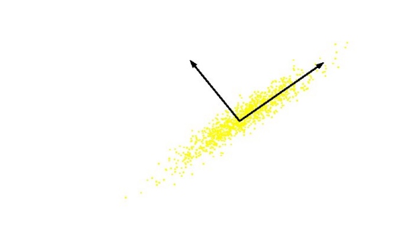
Principal Component Analysis
Principal Component Analysis (PCA) is Unsupervised technique for extracting variance structure from high dimensional datasets.

Slide 12
Principal Component Analysis
In the case of a large set of correlated variables, principal component analysis helps in summarizing the data set with a small number of representative variables that explains most of the variability in the data.
The principal component directions are the directions in the feature space along which the original data is highly variable

Slide 13
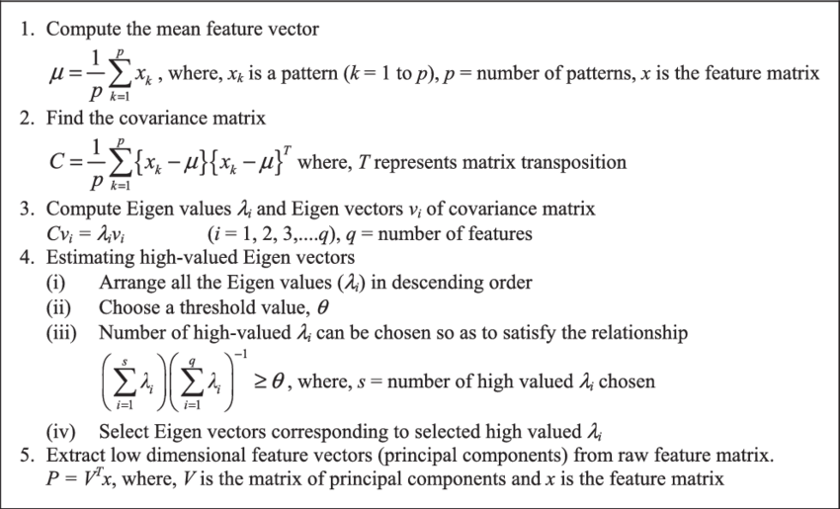
Principal Component Analysis
Algorithm of PCA

Slide 14
Linear Discriminant Analysis

Slide 15
Linear Discriminant Analysis
Linear Discriminant Analysis (LDA) is most commonly used as dimensionality reduction technique in the pre-processing step for pattern-classification and machine learning applications.
Linear Discriminant Analysis (LDA) seeks to discover a linear combination of features that maximizes class separation within a dataset.
LDA’s primary purpose is not merely to reduce dimensions, but rather to perform accurate classifications.
The general LDA approach is very similar to a Principal Component Analysis \but in addition to finding the component axes that maximize the variance of our data (PCA), we are additionally interested in the axes that maximize the separation between multiple classes (LDA).

Slide 16
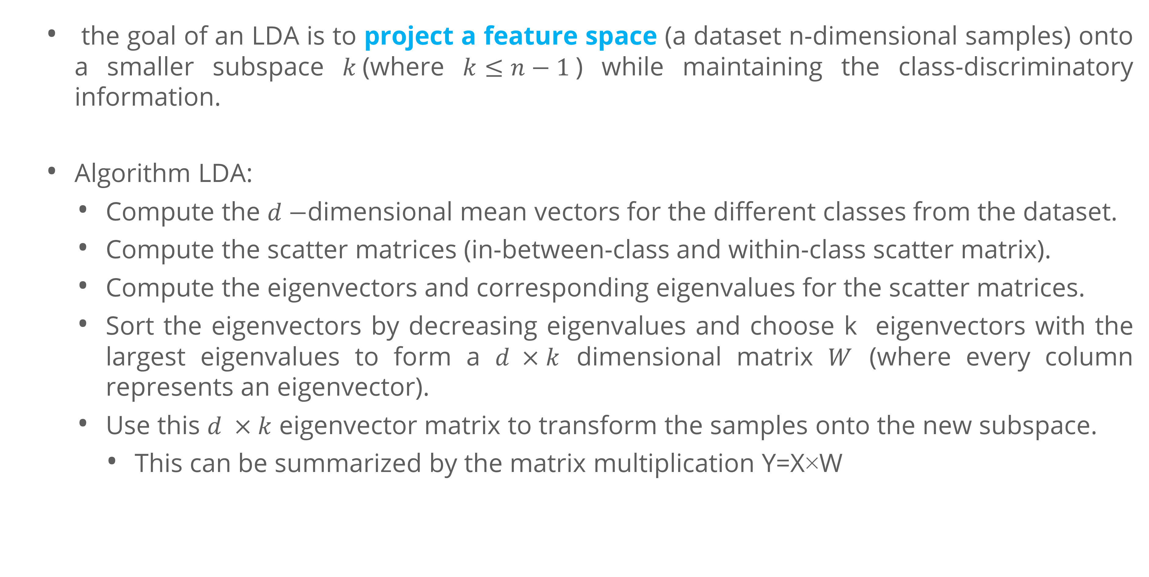
Linear Discriminant Analysis
the goal of an LDA is to project a feature space (a dataset n-dimensional samples) onto a smaller subspace $k$(where $k≤n−1$) while maintaining the class-discriminatory information.
Algorithm LDA:
Compute the $d−$dimensional mean vectors for the different classes from the dataset.
Compute the scatter matrices (in-between-class and within-class scatter matrix).
Compute the eigenvectors and corresponding eigenvalues for the scatter matrices.
Sort the eigenvectors by decreasing eigenvalues and choose k eigenvectors with the largest eigenvalues to form a $d ×k$ dimensional matrix $W$ (where every column represents an eigenvector).
Use this $d ×k$ eigenvector matrix to transform the samples onto the new subspace.
This can be summarized by the matrix multiplication Y=X×W

Slide 17
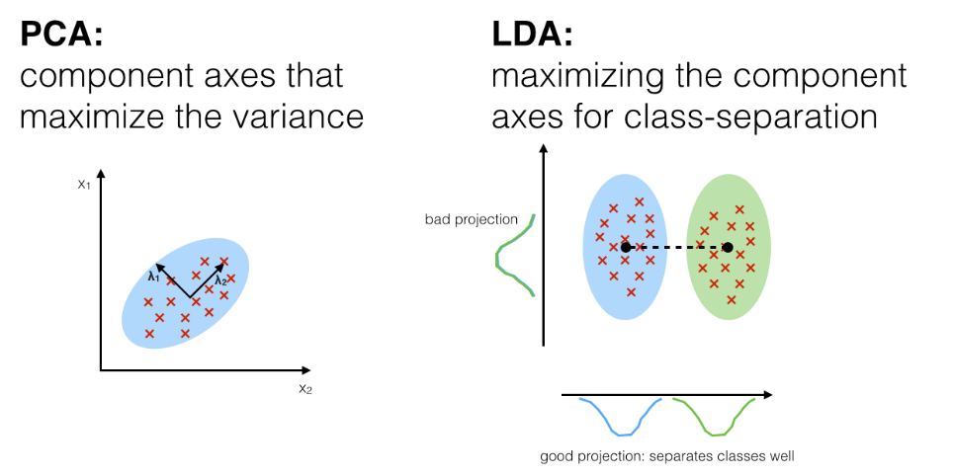
Linear Discriminant Analysis
PCA vs LDA

Slide 18
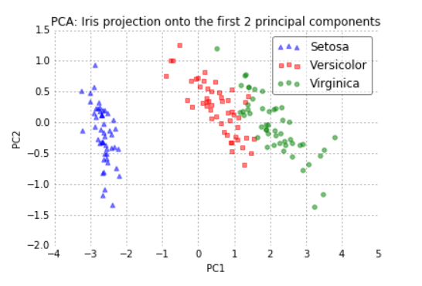
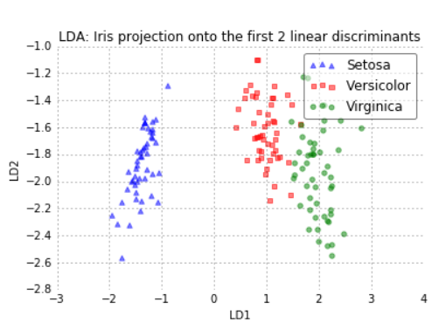
Linear Discriminant Analysis
PCA vs LDA
From two plots above, he PCA accounts for the most variance in the whole dataset, the LDA gives us the axes that account for the most variance between the individual classes.

Slide 19
t-distributed stochastic neighbor embedding

Slide 20
t-distributed stochastic neighbor embedding
t-distributed stochastic neighbor embedding (T-SNE) is an alternative dimensionality reduction algorithm.
PCA tries to find a global structure
Low dimensional subspace
Can lead to local inconsistencies
Far away point can become nearest neighbors
t-SNE tries to perserve local structure
Low dimensional neighborhood should be the same as original neighborhood.
Unlike PCA almost only used for visualization
No easy way to embed new points

Slide 21
t-distributed stochastic neighbor embedding
t-distributed stochastic neighbor embedding (T-SNE) is an alternative dimensionality reduction algorithm.
PCA tries to find a global structure
Low dimensional subspace
Can lead to local inconsistencies
Far away point can become nearest neighbors
t-SNE tries to perserve local structure
Low dimensional neighborhood should be the same as original neighborhood.
non-linear dimensionality reduction technique that has better performance.
It is designed for visualization purposes.

Slide 22
t-distributed stochastic neighbor embedding
Stochastic Neighbor Embedding
SNE basic idea:
”Encode” high dimensional neighborhood information as a distribution
Intuition: Random walk between data points
High probability to jump to a close point
Find low dimensional points such that their neighborhood distribution is similar.
Measures the similarity between two probability distributions & it is asymmetric using KL-Divergence

Slide 23
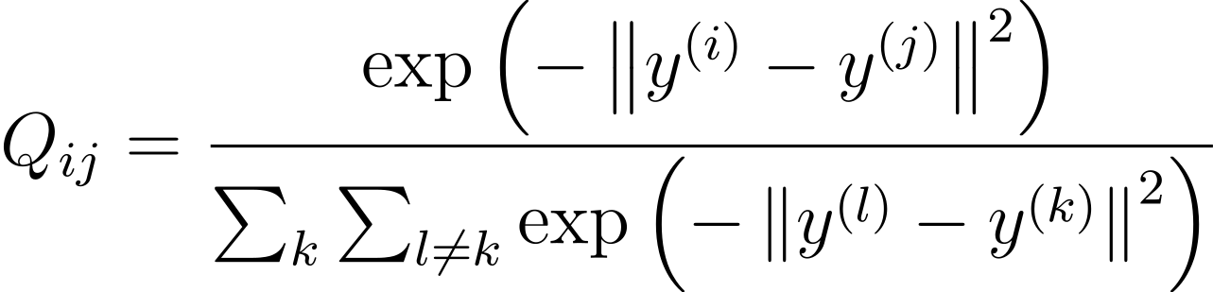
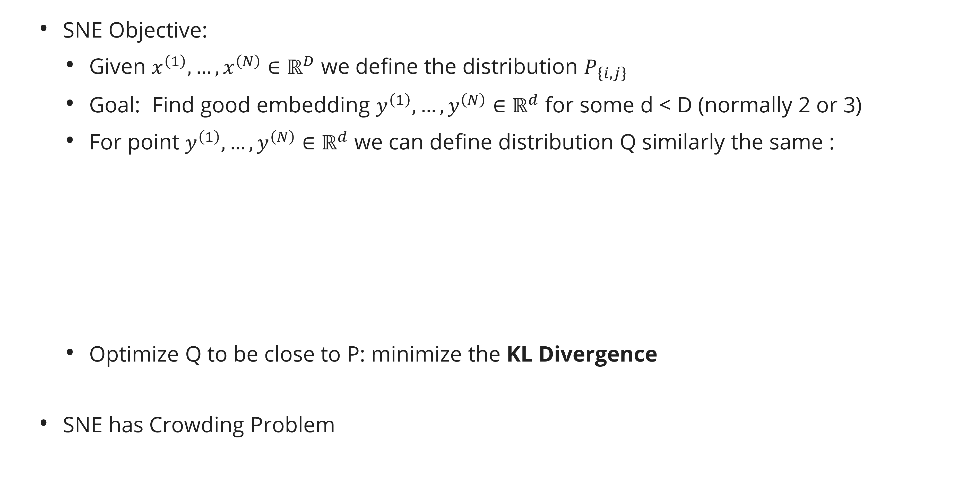
t-distributed stochastic neighbor embedding
Stochastic Neighbor Embedding
SNE Objective:
Given $x^{\left(1\right)},…, x^{\left(N\right)}∈ℝ^{D}$ we define the distribution $P_{\left\{i,j\right\}}$
Goal: Find good embedding $y^{\left(1\right)},…, y^{\left(N\right)}∈ℝ^{d}$ for some d < D (normally 2 or 3)
For point $y^{\left(1\right)},…, y^{\left(N\right)}∈ℝ^{d}$ we can define distribution Q similarly the same :
Optimize Q to be close to P: minimize the KL Divergence
SNE has Crowding Problem

Slide 24
t-distributed stochastic neighbor embedding
Crowding Problem
In high dimension we have more room, points can have a lot of different neighbors
In 2D a point can have a few neighbors at distance one all far from each other - what happens when we embed in 1D?
This is the ”crowding problem” - we don’t have enough room to accommodate all neighbors
This is one of the biggest problems with SNE.
t-SNE solution: Change the Gaussian in Q to a heavy tailed distribution.
if Q changes slower, we have more ”wiggle room” to place points at

Slide 25
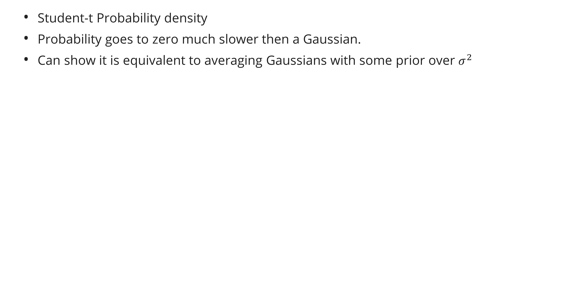
t-distributed stochastic neighbor embedding
Student-t Probability density
Probability goes to zero much slower then a Gaussian.
Can show it is equivalent to averaging Gaussians with some prior over $σ^{2}$

Slide 26
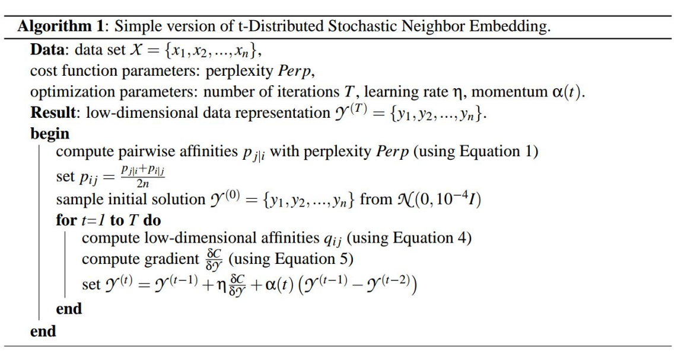
t-distributed stochastic neighbor embedding

Slide 27
Exercise

Slide 28
Exercise
You are a data scientist at a financial institution, tasked with enhancing the fraud detection capabilities of the company. You have been provided with a large and complex dataset containing transactional data, which is suspected to have many redundant or irrelevant features(https://www.kaggle.com/datasets/shayannaveed/credit-card-fraud-detection) . Your goal is to apply dimensionality reduction techniques to streamline the data, aiding in the development of an effective fraud detection model.
Choose appropriate dimensionality reduction techniques such as Principal Component Analysis (PCA), t-Distributed Stochastic Neighbor Embedding (t-SNE), or Linear Discriminant Analysis (LDA).
Apply the selected technique to reduce the number of features while retaining the most informative aspects of the data.

Slide 29
References

Slide 30
References
Géron, A. (2019). Hands-on machine learning with Scikit-Learn, Keras, and TensorFlow: Concepts, tools, and techniques to build intelligent systems (Second edition). O’Reilly.
James, G., Witten, D., Hastie, T., Tibshirani, R., & Taylor, J. E. (2023). An introduction to statistical learning: With applications in Python. Springer.
Abulizi, N. (2023, July 6). Linear Discriminant Analysis (LDA): Unleashing Classification Power with Dimensionality Reduction. Medium. https://nijat.medium.com/linear-discriminant-analysis-lda-unleashing-classification-power-with-dimensionality-reduction-3b8011163d43
Elhabian, S., & Farag, A. A. (n.d.). Linear Discriminant Analysis (LDA). A Tutorial on Data Reduction. Retrieved November 18, 2023, from https://www.sci.utah.edu/~shireen/pdfs/tutorials/Elhabian_LDA09.pdf

Slide 31
References
Fetaya, E., Lucas, J., & Emad, A. (2017). T-SNE. CSC 411 Lecture. https://www.cs.toronto.edu/~jlucas/teaching/csc411/lectures/lec13_handout.pdf
Gs, V., Pai, S. P., Sriram, N., & Rao, R. B. (2013). Radial basis function neural network based comparison of dimensionality reduction techniques for effective bearing diagnostics. Proceedings of the Institution of Mechanical Engineers, Part J: Journal of Engineering Tribology, 227(6), 640–653. https://doi.org/10.1177/1350650112464927
Raschka, S. (2014). Linear Discriminant Analysis. Sebastian Raschka. https://sebastianraschka.com/Articles/2014_python_lda.html
Spruyt, V. (2014, April 16). The Curse of Dimensionality in Classification. Computer Vision for Dummies. https://www.visiondummy.com/2014/04/curse-dimensionality-affect-classification/

